Slide 1
How can we observe two-state transitions?
Any methods that can distinguish between U and N
Absorbance (e.g. Trp, Tyr) due to change in the micro-environment
Fluorescence (Trp)-difference in emission spectrum & intensity, due to change in microenvironment
Circular dichroism (far or near UV), due to change in asymmetric environment of fluorophores
Calorimetry (DSC), due to change in heat capacity and heat absorption
NMR spectroscopy
Gel electrophoresis or size exclusion chromatography
Catalytic activity, functional assays
External probes (chromophores, fluorophores)

Slide 2
Absorption processes
Definition of light absorption:
a photon of energy
is absorbed by a molecule:
Fate of the excited state:
  internal conversion: heat
  emission of a photon: fluroescence, phosophorescence
Jablonski diagram
Intersystem crossing
2
1
S1
0
2
1
T1
0
2
1
S0
0

Slide 3
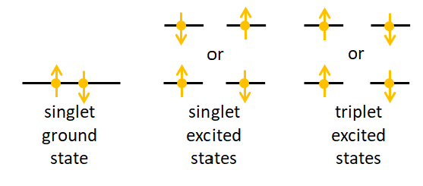
Part II: Emission spectroscopy
Emission from a singlet state:
Fluorescence
from a triplet state:
Phosphorescence
excitation into triplet requires spin-change in electron
similarly, emission from a triplet state requires spin change
|spin| = 0
|spin| = 1
0
+1
or
-1

Slide 4
Lifetimes of excited states and emission
2
1
Absorption
time: 10⁻¹⁵ s, corresponds to the time it takes for light wave to pass molecule
Internal conversion
Molecule returns to lowest singlet state, lowest vibrational niveau
time: 10⁻¹² s
S3
0
internal conversion: 10⁻¹² s
2
1
S1
0
2
1
T1
0
absorption: 10⁻¹⁵ s
2
1
S0
0

Slide 5
Lifetimes of excited states and emission
2
Fluorescence
time: 10⁻⁸ - 10⁻¹⁰ s
Nonradiative, internal conversion
time: 10⁻⁸ - 10⁻¹⁰ s
1
S3
0
2
1
S1
0
2
1
T1
0
non-radiative
nano-seconds
fluorescence
nanoseconds
2
1
S0
0

Slide 6
Lifetimes of excited states and emission
2
Intersystem crossing
time: 10⁻⁸ s
inversion of the electron spin
Phosphorescence
time: 10² - 10⁻⁴ s
requires again inversion of e- spin
forbidden transition, thus long timescale
1
S3
0
Intersystem crossing, 10⁻⁸ s
2
1
S1
0
2
1
T1
0
Phosphorescence
s−μs timescale
2
1
S0
0

Slide 7
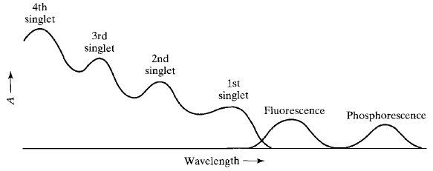
Absorption and emission spectra
2
Spectra:
Fluorescence is red-shifted to the absorption spectrum
phophorescence is at even higher wavelengths
1
S3
0
2
1
S1
0
2
1
T1
0
fluorescence
internal conversion
phosphorescence
2
1
S0
0

Slide 8
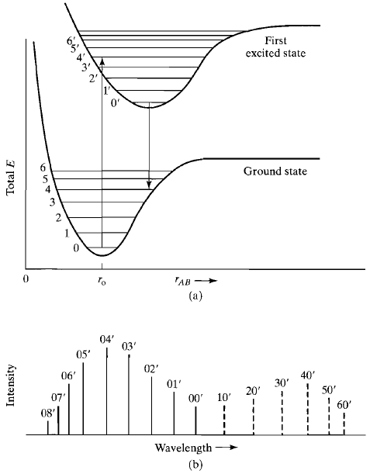
Fluorescence spectrum
Shape of fluroescence spectra:
The arrows denote the most probable transitions from
ground state -> s1
s1 -> ground state
The fluorescence spectrum is a mirror image of the absorption spectrum
the different in absorbance and fluorescence maximum is the stokes shift

Slide 9
Fluorescence spectrum
Shape of fluroescence spectra:
The arrows denote the most probable transitions from
ground state -> s1
s1 -> ground state
The fluorescence spectrum is a mirror image of the absorption spectrum
the different in absorbance and fluorescence maximum is the stokes shift
stokes shift

Slide 10
Quantum yield
The quantum yield is defined as:
Even with a quantum yield Q_{F} = 1, the energy output is below 100%, as the fluorescence is at a higher wavelength.
Strong fluorescence observed with molecules with strong π-π∗ absorption, n-π* transitions often do not fluroesce.

Slide 11

Measuring fluorescence
grating
excitation monochromator
Xe lamp
slit
sample cell
Single photons are detected
Fluroescence spectrometry is 10³ to 10⁴ times more sensitive than absorption spectroscopy
slit
grating
photomultiplier
emission monochromator

Slide 12
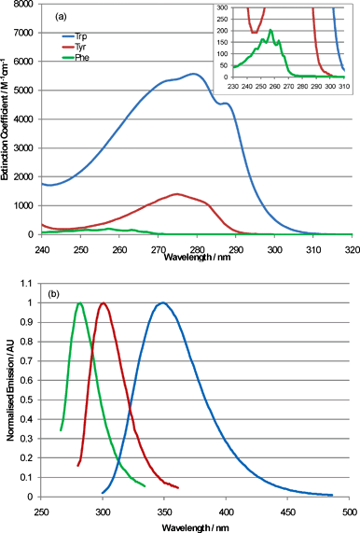
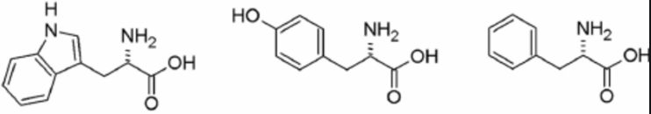
Amino acids: Fluroescence spectra
Absorbance and fluroescence spectra of aromatic amino acids
Trp
Tyr
Phe
Quantum yield for tryptophan: Q_{F}=0.2
Depends on environment

Slide 13
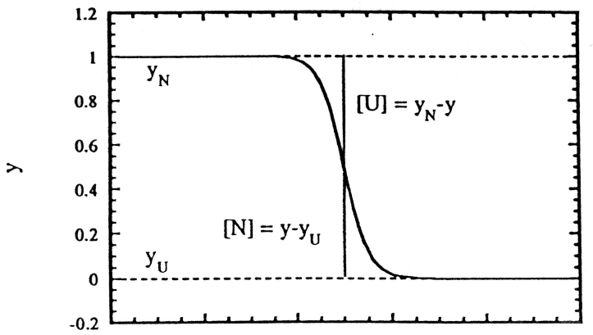
Denaturation of globular, monomeric protein (2-states)
Isolated protein in solution
We monitor one variable (e.g. tyrosine fluorescence) and vary another variable (e.g. temperature or a chemical denaturant)
D
midpoint of transition
D
D
[denaturant] (M)

Slide 14
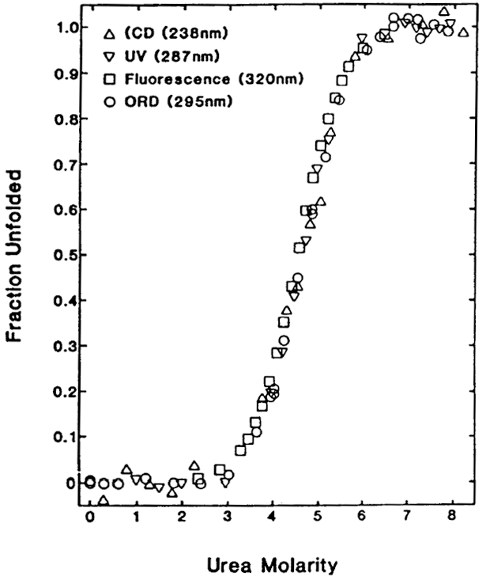
Denaturation of globular, monomeric protein : RNase T1
different parameters completely overlap
normalized transitions (θ_{N} = [N] / ([N] + [D])) overlap

Slide 15
Three (or more) state equilibrium transitions
In many proteins, intermediates are populated.
Intermediates include proteins, where only partial structure has formed.
This complicates the analysis.
free energy
D
I
N
reaction coordinate x

Slide 16
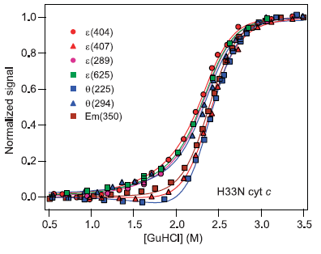
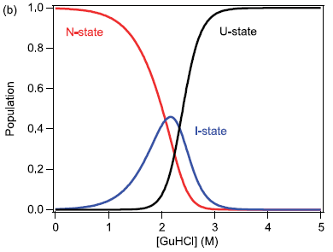
Multistate transitions in cytochrome c unfolding
Latypov et al. JMB 2006
If different parameters are observed, unfolding traces do no longer coincide.
Intermediates accumulate during the unfolding transition

Slide 17
Multi-state transition
unfolding intermediates
apparent stability, eludicated by summing the individual contributions

Slide 18
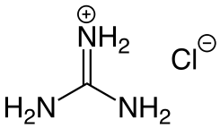

Denaturation with chemical agents
Molecular mechanism of denaturant action:
Direct effect:
  H-bonding to polar groups, mostly the protein backbone, thereby competing with internal H-bonds
  If charged: Interaction with ionic groups
Indirect effect:
  Alteration of water structure and thus diminishment of the hydrophobic effect
  Facilitation of the exposure of hydrophobic groups.
guanidinium
chloride
urea

Slide 19
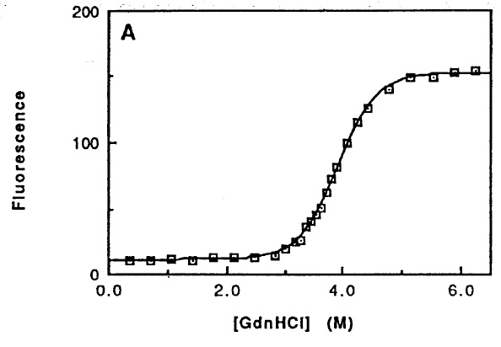
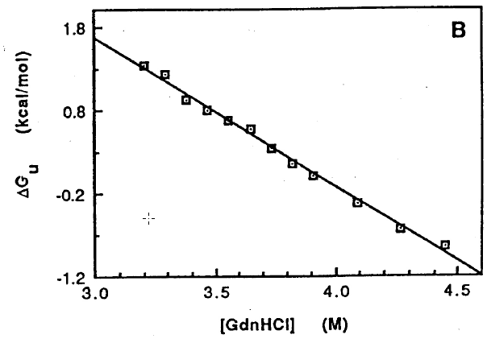
Protein denaturation with denaturants
Example: Chymotrypsin inhibitor 2 (CI2)
The effect of denaturants on the free energy is linear (empirical finding)
The free energy of unfolding can thus be determined by an extrapolation to 0 M denaturant

Slide 20
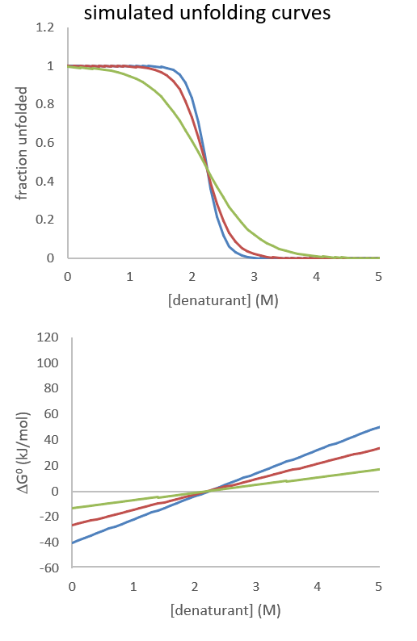
Sensitivity to denaturant
simulated unfolding curves
Parameters
ΔG₀ = -40 kJ/mol, m = 18 kJ/mol/M
ΔG₀ = -26.5 kJ/mol, m = 12 kJ/mol/M
ΔG₀ = -13.1 kJ/mol, m = 6 kJ/mol/M
molecular meaning of m-value:
proportional of buried ASA
proteins with large hydrophobic core exhibit high m-value
the higher the m-value the stronger the dependence of a folding transition to denaturant (steepness)

Slide 21
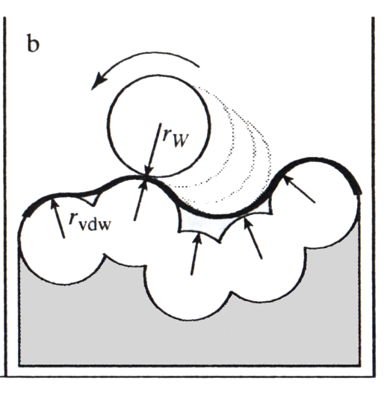
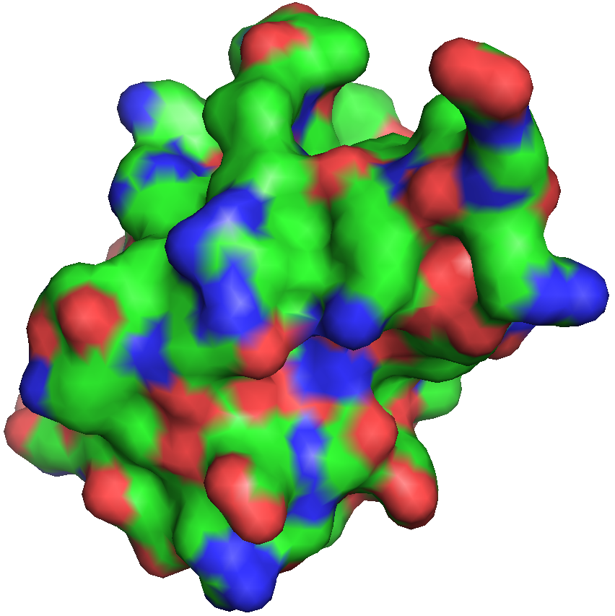
M-values are proportional to change in ASA
Calculating ASA
a water-sized sphere is rolled across the chemical structure keeping VdW radii
the accessible surface corresponds to the ASA
molecular meaning of m-value:
proportional to change in ASA
proteins with large hydrophobic core exhibit high m-value
the higher the m-value the stronger the dependence of a folding transition to denaturant (steepness)

